Slide 1
Program Representations

Slide 2
Representing programs
Goals

Slide 3
Representing programs
Primary goals
  analysis is easy and effective
    just a few cases to handle
    directly link related things
  transformations are easy to perform
  general, across input languages and target machines
Additional goals
  compact in memory
  easy to translate to and from
  tracks info from source through to binary, for source-level debugging, profilling, typed binaries
  extensible (new opts, targets, language features)
  displayable

Slide 4
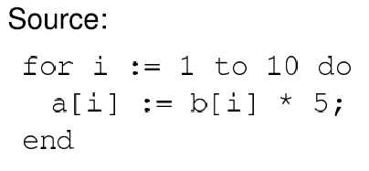
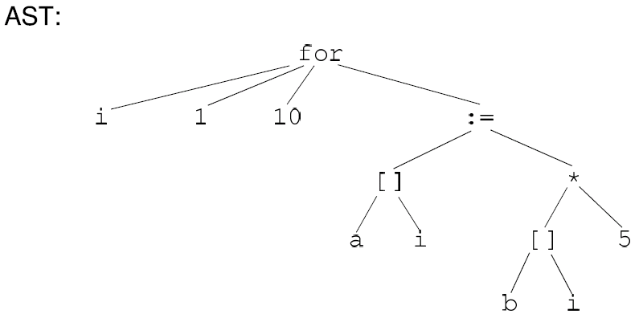
Option 1: high-level syntax based IR
Represent source-level structures and expressions directly
Example: Abstract Syntax Tree

Slide 5
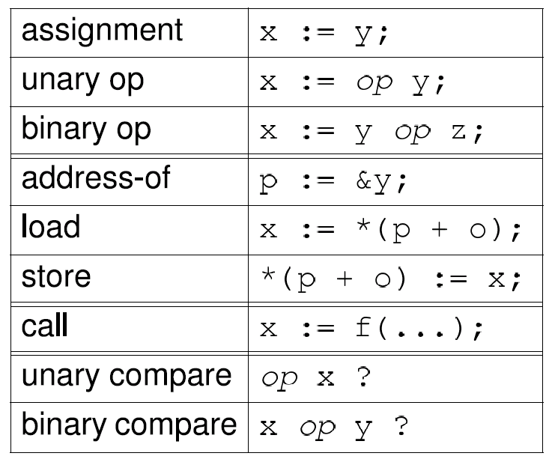
Option 2: low-level IR
Translate input programs into low-level primitive chunks, often close to the target machine
Examples: assembly code, virtual machine code (e.g. stack machines), three-address code, register-transfer language (RTL)
Standard RTL instrs:

Slide 6
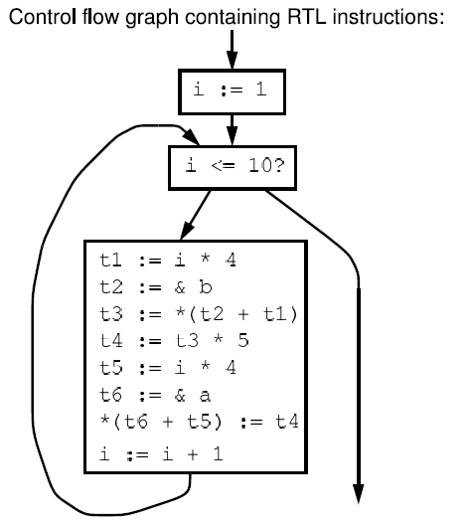
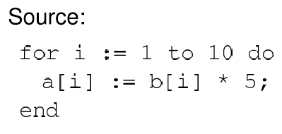
Option 2: low-level IR

Slide 7
Comparison

Slide 8
Comparison
Advantages of high-level rep
  analysis can exploit high-level knowledge of constructs
  easy to map to source code (debugging, profiling)
Advantages of low-level rep
  can do low-level, machine specific reasoning
  can be language-independent
Can mix multiple reps in the same compiler

Slide 9
Components of representation
Control dependencies: sequencing of operations
  evaluation of if & then
  side-effects of statements occur in right order
Data dependencies: flow of definitions from defs to uses
  operands computed before operations
Ideal: represent just dependencies that matter
  dependencies constrain transformations
  fewest dependences ) flexibility in implementation

Slide 10
Control dependencies
Option 1: high-level representation
  control implicit in semantics of AST nodes
Option 2: control flow graph (CFG)
  nodes are individual instructions
  edges represent control flow between instructions
Options 2b: CFG with basic blocks
  basic block: sequence of instructions that don’t have any branches, and that have a single entry point
  BB can make analysis more efficient: compute flow functions for an entire BB before start of analysis

Slide 11
Control dependencies
CFG does not capture loops very well
Some fancier options include:
  the Control Dependence Graph
  the Program Dependence Graph
More on this later. Let’s first look at data dependencies

Slide 12
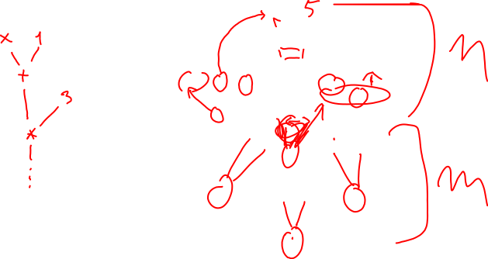
Data dependencies
Simplest way to represent data dependencies: def/use chains
x := ...
y := ...
... x ...
x := x + y
... x ...
x := ...
y := y + 1
... x ...
... y ...
... y ...
... y ...
... y ...

Slide 13
Def/use chains
Directly captures dataflow
  works well for things like constant prop
But...
Ignores control flow
  misses some opt opportunities since conservatively considers all paths
  not executable by itself (for example, need to keep CFG around)
  not appropriate for code motion transformations
Must update after each transformation
Space consuming

Slide 14
SSA
Static Single Assignment
  invariant: each use of a variable has only one def

Slide 15
x := ...
y := ...
... x ...
x := x + y
... x ...
x := ...
y := y + 1
... x ...
... y ...
... y ...
... y ...
... y ...

Slide 16
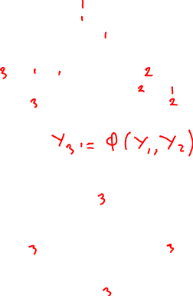
x := ...
y := ...
... x ...
x := x + y
... x ...
x := ...
y := y + 1
... x ...
... y ...
... y ...
... y ...
... y ...

Slide 17
SSA
Create a new variable for each def
Insert φ pseudo-assignments at merge points
Adjust uses to refer to appropriate new names
Question: how can one figure out where to insert φ nodes using a liveness analysis and a reaching defns analysis.

Slide 18
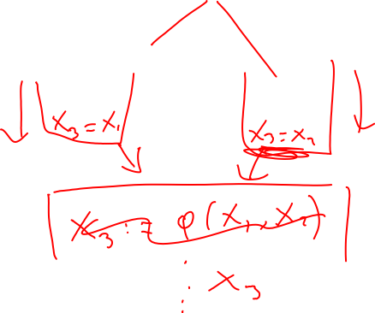
Converting back from SSA
Semantics of x₃ := φ(x₁, x₂)
  set x₃ to x_{i} if execution came from ith predecessor
How to implement φ nodes?

Slide 19
Converting back from SSA
Semantics of x₃ := φ(x₁, x₂)
  set x₃ to x_{i} if execution came from ith predecessor
How to implement φ nodes?
  Insert assignment x₃ := x₁ along 1st predecessor
  Insert assignment x₃ := x₂ along 2nd predecessor
If register allocator assigns x₁, x₂ and x₃ to the same register, these moves can be removed
  x₁ .. x_{n} usually have non-overlapping lifetimes, so this kind of register assignment is legal

Slide 20




Recall: Common Sub-expression Elim
Want to compute when an expression is available in a var
Domain:

Slide 21

Recall: CSE Flow functions
in
F_{X := Y op Z}(in) = in – { X ! * }
– { * ! ... X ... } [
{ X ! Y op Z | X ≠ Y Æ X ≠ Z}
X := Y op Z
out
in
F_{X := Y}(in) = in – { X ! * }
– { * ! ... X ... } [
{ X ! E | Y ! E 2 in }
X := Y
out

Slide 22







Example
i := a + b
x := i * 4
j := i
i := c
z := j * 4
y := i * 4
i := i + 1
m := b + a
w := 4 * m

Slide 23
Problems
z := j * 4 is not optimized to z := x, even though x contains the value j * 4
m := b + a is not optimized, even though a + b was already computed
w := 4 * m it not optimized to w := x, even though x contains the value 4 *m

Slide 24
Problems: more abstractly
Available expressions overly sensitive to name choices, operand orderings, renamings, assignments
Use SSA: distinct values have distinct names
Do copy prop before running available exprs
Adopt canonical form for commutative ops

Slide 25
Example in SSA
in
X := Y op Z
F_{X := Y op Z}(in) =
out
in₀
in₁
F_{X := φ (Y,Z)}(in₀, in₁) =
X := φ(Y,Z)
out

Slide 26
Example in SSA
in
X := Y op Z
F_{X := Y op Z}(in) = in [ { X ! Y op Z }
out
in₀
in₁
F_{X := φ (Y,Z)}(in₀, in₁) = (in₀ Å in₁ ) [
{ X ! E | Y ! E 2 in₀ Æ Z ! E 2 in₁ }
X := φ(Y,Z)
out

Slide 27
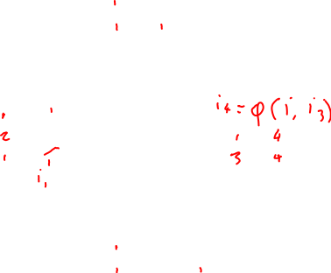
Example in SSA
i := a + b
x := i * 4
j := i
i := c
z := j * 4
y := i * 4
i := i + 1
m := b + a
w := 4 * m

Slide 28

Example in SSA
i₁ := a₁ + b₁
x₁ := i₁ * 4
j₁ := i₁
i₂ := c₁
z₁ := i₁ * 4
i₄ := φ(i₁,i₃)
y₁ := i₄ * 4
i₃ := i₄ + 1
m₁ := a₁ + b₁
w₁ := m₁ * 4

Slide 29
What about pointers?
Pointers complicate SSA. Several options.
Option 1: don’t use SSA for pointed to variables
Option 2: adapt SSA to account for pointers
Option 3: define src language so that variables cannot be pointed to (eg: Java)

Slide 30
SSA helps us with CSE
Let’s see what else SSA can help us with
Loop-invariant code motion

Slide 31
Loop-invariant code motion
Two steps: analysis and transformations
Step1: find invariant computations in loop
  invariant: computes same result each time evaluated
Step 2: move them outside loop
  to top if used within loop: code hoisting
  to bottom if used after loop: code sinking

Slide 32

Example
x := 3
y := 4
y := 5
z := x * y
q := y * y
w := y + 2
w := w + 5
p := w + y
x := x + 1
q := q + 1

Slide 33

Example
x := 3
y := 4
y := 5
z := x * y
q := y * y
w := y + 2
w := w + 5
p := w + y
x := x + 1
q := q + 1

Slide 34
Detecting loop invariants
An expression is invariant in a loop L iff:
(base cases)
  it’s a constant
  it’s a variable use, all of whose defs are outside of L
(inductive cases)
  it’s a pure computation all of whose args are loop-invariant
  it’s a variable use with only one reaching def, and the rhs of that def is loop-invariant

Slide 35
Computing loop invariants
Option 1: iterative dataflow analysis
  optimistically assume all expressions loop-invariant, and propagate
Option 2: build def/use chains
  follow chains to identify and propagate invariant expressions
Option 3: SSA
  like option 2, but using SSA instead of def/use chains

Slide 36
Example using def/use chains
x := 3
An expression is invariant in a loop L iff:
(base cases)
  it’s a constant
  it’s a variable use, all of whose defs are outside of L
(inductive cases)
  it’s a pure computation all of whose args are loop-invariant
  it’s a variable use with only one reaching def, and the rhs of that def is loop-invariant
y := 4
y := 5
z := x * y
q := y * y
w := y + 2
w := w + 5
p := w + y
x := x + 1
q := q + 1

Slide 37
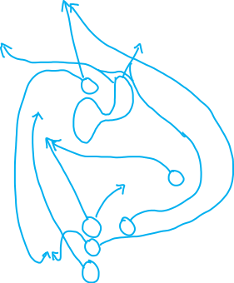

Example using def/use chains
x := 3
An expression is invariant in a loop L iff:
(base cases)
  it’s a constant
  it’s a variable use, all of whose defs are outside of L
(inductive cases)
  it’s a pure computation all of whose args are loop-invariant
  it’s a variable use with only one reaching def, and the rhs of that def is loop-invariant
y := 4
y := 5
z := x * y
q := y * y
w := y + 2
w := w + 5
p := w + y
x := x + 1
q := q + 1

Slide 38
Loop invariant detection using SSA
An expression is invariant in a loop L iff:
(base cases)
  it’s a constant
  it’s a variable use, all of whose single defs are outside of L
(inductive cases)
  it’s a pure computation all of whose args are loop-invariant
  it’s a variable use whose single reaching def, and the rhs of that def is loop-invariant
φ functions are not pure

Slide 39
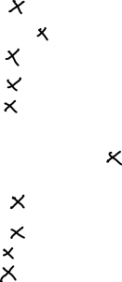
Example using SSA
x₁ := 3
An expression is invariant in a loop L iff:
(base cases)
  it’s a constant
  it’s a variable use, all of whose single defs are outside of L
(inductive cases)
  it’s a pure computation all of whose args are loop-invariant
  it’s a variable use whose single reaching def, and the rhs of that def is loop-invariant
φ functions are not pure
y₁ := 4
y₂ := 5
x₂ := φ(x₁,x₃)
y₃ := φ(y₁,y₂,y₃)
z₁ := x₂ * y₃
q₁ := y₃ * y₃
w₁ := y₃ + 2
w₂ := w₁ + 5
w₃ := φ(w₁,w₂)
p₁ := w₃ + y₃
x₃ := x₂ + 1
q₂ := q₁ + 1

Slide 40
Example using SSA and preheader
x₁ := 3
An expression is invariant in a loop L iff:
(base cases)
  it’s a constant
  it’s a variable use, all of whose single defs are outside of L
(inductive cases)
  it’s a pure computation all of whose args are loop-invariant
  it’s a variable use whose single reaching def, and the rhs of that def is loop-invariant
φ functions are not pure
y₁ := 4
y₂ := 5
y₃ := φ(y₁,y₂)
x₂ := φ(x₁,x₃)
z₁ := x₂ * y₃
q₁ := y₃ * y₃
w₁ := y₃ + 2
w₂ := w₁ + 5
w₃ := φ(w₁,w₂)
p₁ := w₃ + y₃
x₃ := x₂ + 1
q₂ := q₁ + 1

Slide 41
Summary: Loop-invariant code motion
Two steps: analysis and transformations
Step1: find invariant computations in loop
  invariant: computes same result each time evaluated
Step 2: move them outside loop
  to top if used within loop: code hoisting
  to bottom if used after loop: code sinking

Slide 42
Code motion
Say we found an invariant computation, and we want to move it out of the loop (to loop pre-header)
When is it legal?
Need to preserve relative order of invariant computations to preserve data flow among move statements
Need to preserve relative order between invariant computations and other computations

Slide 43
Example
x := 0
y := 1
i := 0
z != 0 &&
i < 100 ?
x := a * b
y := x / z
i := i + 1
q := x + 1

Slide 44
Lesson from example: domination restriction
To move statement S to loop pre-header, S must dominate all loop exits
  [ A dominates B when all paths to B first pass through A ]
Otherwise may execute S when never executed otherwise

Slide 45
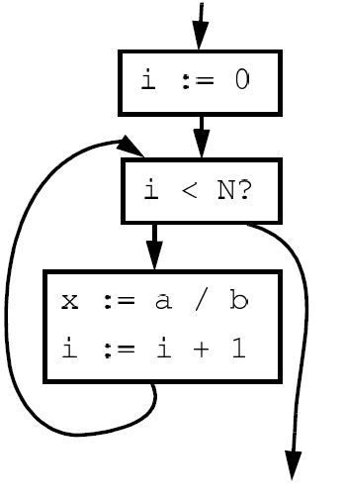

Domination restriction in for loops

Slide 46

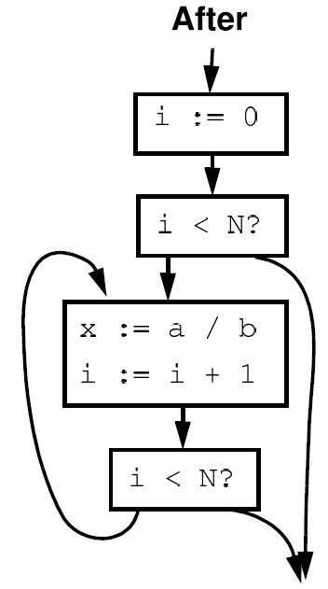

Domination restriction in for loops

Slide 47
Avoiding domination restriction
Domination restriction strict
  Nothing inside branch can be moved
  Nothing after a loop exit can be moved
Can be circumvented through loop normalization
  while-do => if-do-while

Slide 48
Another example
z := 5
i := 0
z := z + 1
z := 0
i := i + 1
i < N ?
... z ...

Slide 49
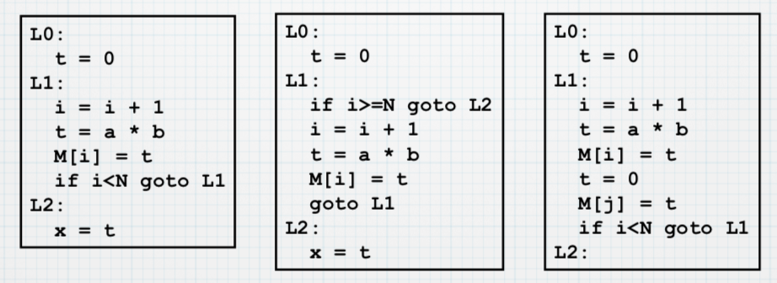
Data dependence restriction
To move S: z := x op y:
S must be the only assignment to z in loop, and no use of z in loop reached by any def other than S.
Otherwise may reorder defs/uses.

Slide 50
Avoiding data restriction
z := 5
i := 0
z := z + 1
z := 0
i := i + 1
i < N ?
... z ...

Slide 51
Avoiding data restriction
z₁ := 5
i₁ := 0
Restriction unnecessary in SSA!!!
Implementation of phi nodes as moves will cope with re-ordered defs/uses
z₂ := φ(z₁,z₄)
i₂ := φ(i₁,i₃)
z₃ := z₂ + 1
z₄ := 0
i₃ := i₂ + 1
i₃ < N ?
... z₄ ...

Slide 52
Summary of Data dependencies
We’ve seen SSA, a way to encode data dependencies better than just def/use chains
  makes CSE easier
  makes loop invariant detection easier
  makes code motion easier
Now we move on to looking at how to encode control dependencies

Slide 53





Control Dependencies
A node (basic block) Y is control-dependent on another X iff X determines whether Y executes
  there exists a path from X to Y s.t. every node in the path other than X and Y is post-dominated by Y
  X is not post-dominated by Y

Slide 54
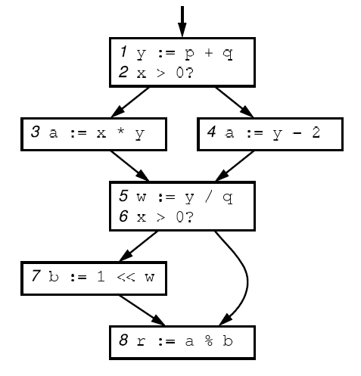

Example

Slide 55

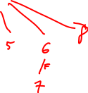

Example

Slide 56
Control Dependence Graph
Control dependence graph: Y descendent of X iff Y is control dependent on X
  label each child edge with required condition
  group all children with same condition under region node
Program dependence graph: super-impose dataflow graph (in SSA form or not) on top of the control dependence graph

Slide 57
Example

Slide 58











Example

Slide 59
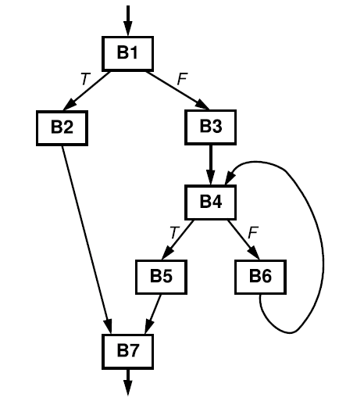
Another example

Slide 60
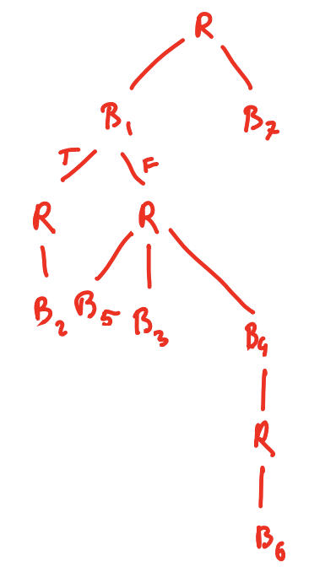
Another example

Slide 61
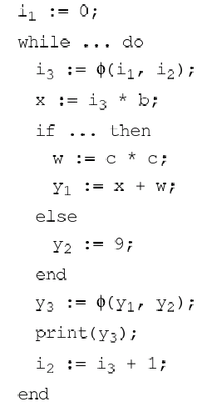


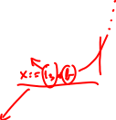


















Another example

Slide 62
Summary of Control Depence Graph
More flexible way of representing control-depencies than CFG (less constraining)
Makes code motion a local transformation
However, much harder to convert back to an executable form

Slide 63
Course summary so far
Dataflow analysis
  flow functions, lattice theoretic framework, optimistic iterative analysis, precision, MOP
Advanced Program Representations
  SSA, CDG, PDG
Along the way, several analyses and opts
  reaching defns, const prop & folding, available exprs & CSE, liveness & DAE, loop invariant code motion
Next: Pointer analysis and dealing with procedures

